Slide 1
AI
Adventures
Enoch Olusanya, Daniel Esemezie

Slide 2
Table of contents
01
02
03
Problem Statement
Business concept analyzer
Demo

Slide 3

01
Problem Statement

Slide 4
Problem Statement
Problem
Our idea
Develop an algorithmic tool that features generative AI to assist in the evaluation of ideas
Develop an AI that can evaluate the potential success of a business idea given existing market conditions and other factors (Rates how good your idea is and iterates it to make it better)

Slide 5
Business Concept Analyzer
What?
How?
Utilizing Advanced AI algorithm for predictive analysis and idea iteration
A comprehensive tool integrating both external and internal business factors

Slide 6
Some inputs/data sets needed
External Factors
Internal Factors
Current Economic Conditions
Location
Industry
Competitors
Synergies
Market size
Strategy
Management
Financing
Stability of the market
Risks

Slide 7
AI Business Evaluator
Innovative solutions
Need for Data driven Decision Making
Analyze existing customer needs and identify gaps in the market to find new opportunities
There are limitations of traditional evaluation methods in capturing real-time market conditions
Stay ahead of trends
Complex Market Dynamics
Monitor changes in the marketplace, such as shifts in consumer behavior or emerging technologies, to stay competitive and capitalize on new opportunities and trends
With so many factors to consider when developing an idea, the need for AI is apparent in order to take it all into consideration and identify trends

Slide 8
External: Analysis and importance
Location
Industry Dynamics
Geographical Impacts on business success
Understanding sector-specific trends
Competitors
Market size and Synergies
Assessing Market competition
Evaluating potential customer base and Identifying beneficial external partnerships

Slide 9
Internal: Analysis and importance
Strategy
Management
Aligning idea with strategic objectives
Role of leadership and team dynamics
Financing
Current economic conditions and risks
Financial health and funding strategy
Impact of the broader economy and assessing internal vulnerabilities

Slide 10
How AI processes Data
Data integration
Pattern Recognition
Combining diverse data sources for a holistic view
Identify success patterns in similar businesses
Predictive Analysis
Forecasting future trends and challenges, feedback loop for iterations

Slide 11
AI Workflow
Step 1: User accesses the platform
Step 2: User answers prompts that make it easier for system to evaluate idea
Step 3: AI system process information using natural language processing
Step 4: User selects criteria on which to analyze the business idea (market potential, scalability, financial viability, sustainability
Step 5: The AI system evaluates the business idea based on the selected criteria. It assigns scores to different aspects of the idea.

Slide 12
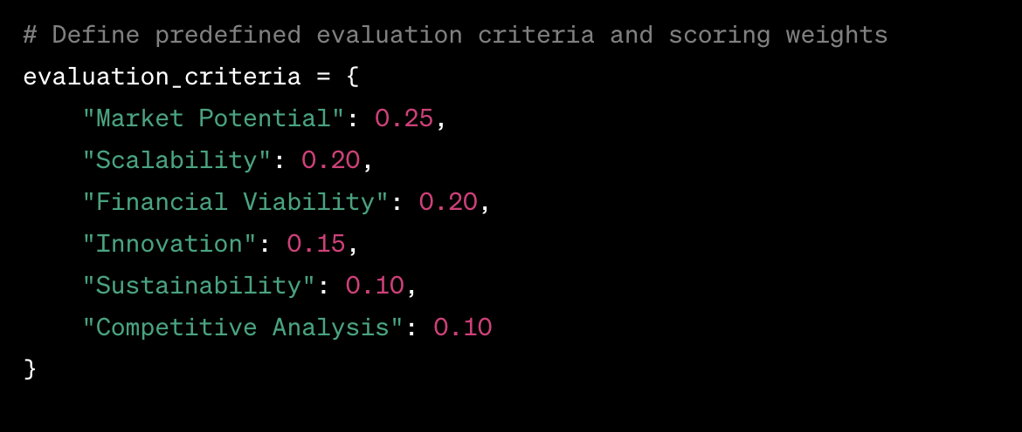
Evaluation criteria
To evaluate overall feasibility of the business concept
Weights are assigned to different evaluation criteria
Main oints
Include impactful st
messae afterwards
Practice presenting your deck beforehand with friends or colleagues for feedback, then use this input to refine it further
deas across

Slide 13
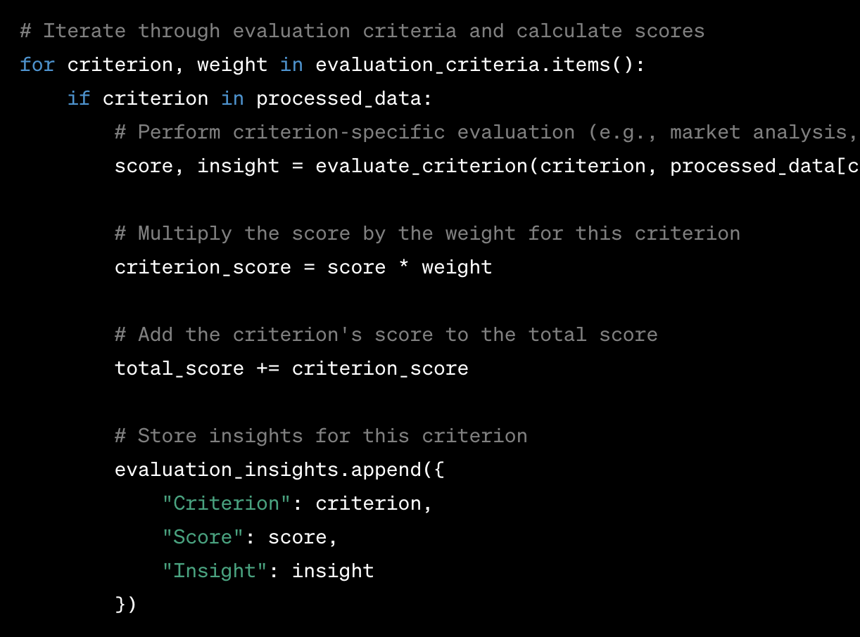
Iterate through the criterion assigning

Slide 14
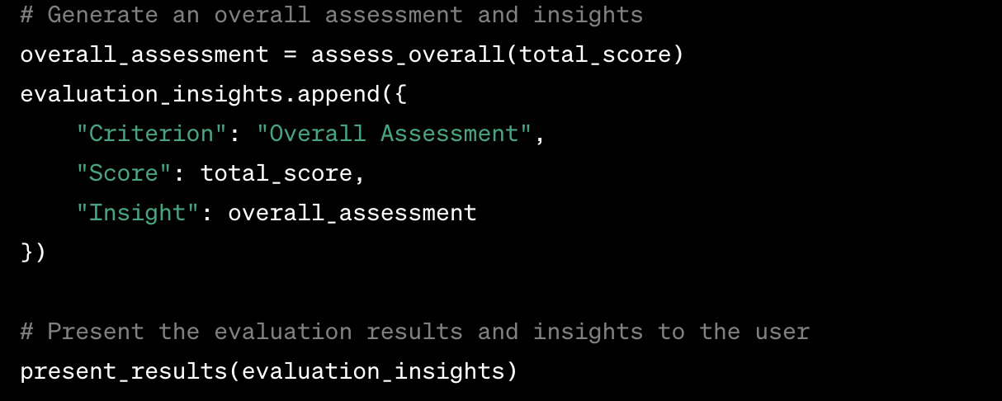
Final Evaluation

Slide 15
Thanks!
Do you have any questions?

Slide 16
Thanks!
Do you have any questions?
Please keep this slide for attribution

